Slide 1
Unit Testing by JUnit

Slide 2
Group Members:
Muhammad Hasan Zahid
Hamza Rashid
Aqib Chaudhary
Ali Hassan

Slide 3
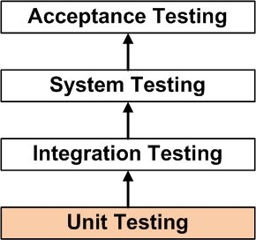
UNIT TESTING is a level of software testing where individual units/ components of a software are tested.
A unit is the smallest testable part of any software.
Purpose is to validate that each unit of the software performs as designed.

Slide 4
J-Unit Testing

Slide 5
J-Unit Testing
JUnit is an open source Unit Testing Framework for JAVA. It is useful for Java Developers to write and run repeatable tests.
Erich Gamma and Kent Beck initially develop it.
As the name implies, it is used for Unit Testing of a small chunk of code.

Slide 6
Why you need J-Unit Testing
It finds bugs early in the code, which makes our code more reliable.
JUnit is useful for developers, who work in a test-driven environment.
Unit testing forces a developer to read code more than writing.
You develop more readable, reliable and bug-free code which builds confidence during development.

Slide 7
J-Unit Test Framework

Slide 8
J-Unit Test Framework
JUnit is a Regression Testing Framework.
It is used by developers to implement unit testing in Java, and accelerate programming speed and increase the quality of code.
JUnit Framework can be easily integrated with either of the following
1) Eclipse
2) Ant
3) Maven

Slide 9
Features of J-Unit Test Framework

Slide 10
Features of J-Unit Test Framework
JUnit test framework provides the following important features
1)Fixtures
2)Test suites
3)Test runners
4)JUnit classes

Slide 11
Fixtures
Fixtures is a fixed state of a set of objects used as a baseline for running tests.
The purpose of a test fixture is to ensure that there is a well-known and fixed environment in which tests are run so that results are repeatable.
It includes
1)setUp() method, which runs before every test invocation.
2)tearDown() method, which runs after every test method.

Slide 12
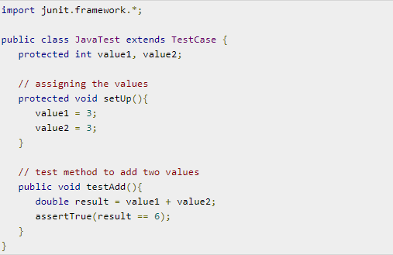
Fixtures

Slide 13
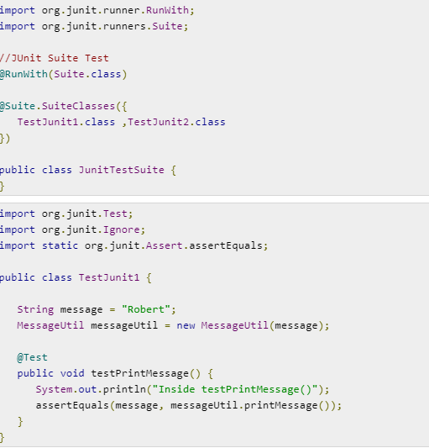
Test Suites

Slide 14
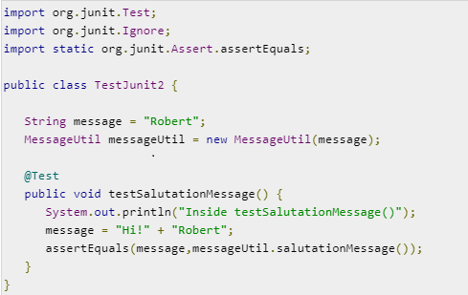
Test Suites

Slide 15
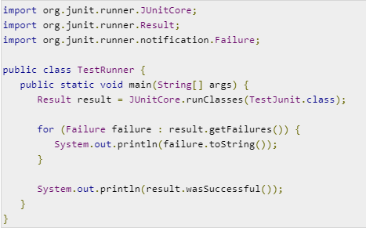
Test Runners

Slide 16
J-Unit Classes
JUnit classes are important classes, used in writing and testing JUnits. Some of the important classes are
1)Assert − Contains a set of assert methods.
2)TestCase − Contains a test case that defines the fixture to run multiple tests.
3) TestResult − Contains methods to collect the results of executing a test case.

Slide 17
Demo

Slide 18
ANY QUESTIONS WILL BE HIGHLY APPRECIATED

Slide 19
Thank you ☺

